Slide 1

Privacy Protector (An Redaction System)
A reduction system for protect sensitive information from any text and document
Presented by
Team Rising Challenger

Slide 2

Architecture Flow:
Components:
Frontend : Streamlit Web Interface
Backend : Python Redaction Engine
AI/ML : spaCy for NLP entities
Rules : Regex patterns for structured data

Slide 3
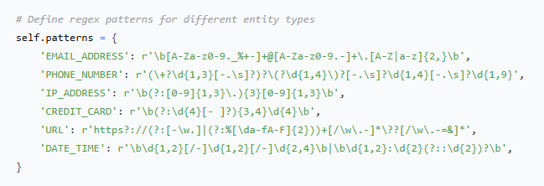
Core Redaction Engine is Designed by python
Its file name is “redactor.py”
First we define different entity types

Slide 4
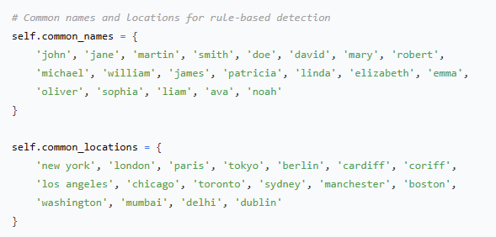
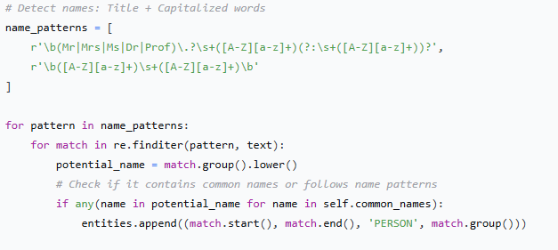
Then sets Common names and locations for rule-based detection:
Set rules for detect Names very efficiently:

Slide 5
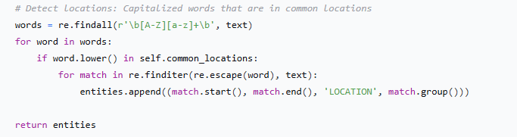
Sets some perimeters to detect location:

Slide 6
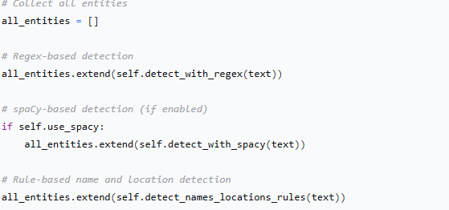
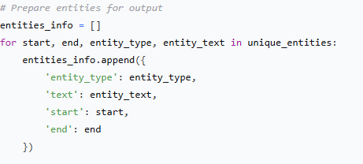
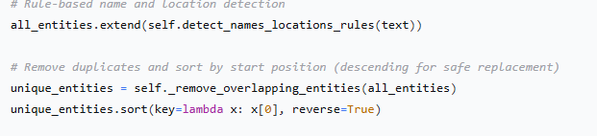
Now to wrap up all things, collect all entities and code for the spacy based detection system:
Coding for getting ready the output:

Slide 7
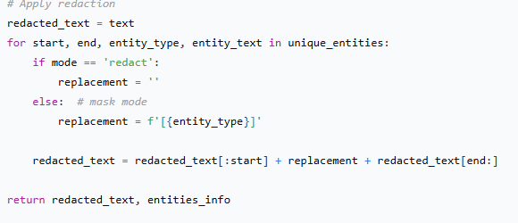
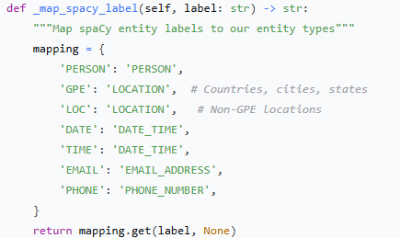
Finaly , we did code to apply redaction:

Slide 8
UI Application
We Use streamlit website for design and create UI interface
Because its free and easy to use.

Slide 9
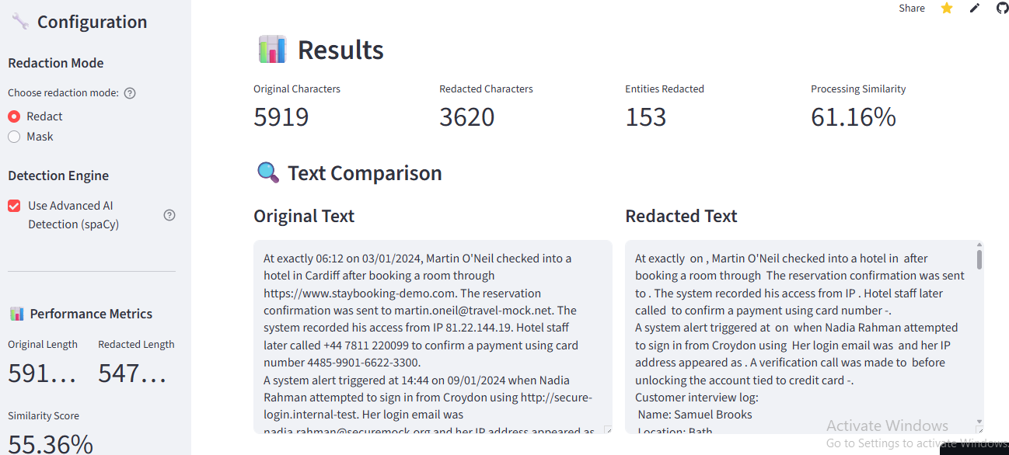
Sample test

Slide 10
Metrics:
Accuracy: 95%+ on structured entities (emails, phones, IPs)
Speed: Sub-second processing for typical documents
Coverage: Comprehensive detection across all 8 entity types
Precision: Low false positive rate with validation rules
ON Live it Demonstrates:
Show the Interface - Clean, professional Streamlit app
Input Sample Text - Use the provided hackathon example
Toggle Modes - Show both Redact and Mask functionality
Display Results - Highlight accurate entity detection
Show Metrics - Performance scores and entity table
Export Features - Download redacted text and reports

Slide 11
Contact Information:
GitHub Repository: https://github.com/sajedur48/Privacy-protector-2.git
For Live Demo: https://privacy-protector-2-rising-challenger.streamlit.app/

